Slide 1
[320] Welcome + First Lecture
[reproducibility]
Meenakshi Syamkumar

Slide 2
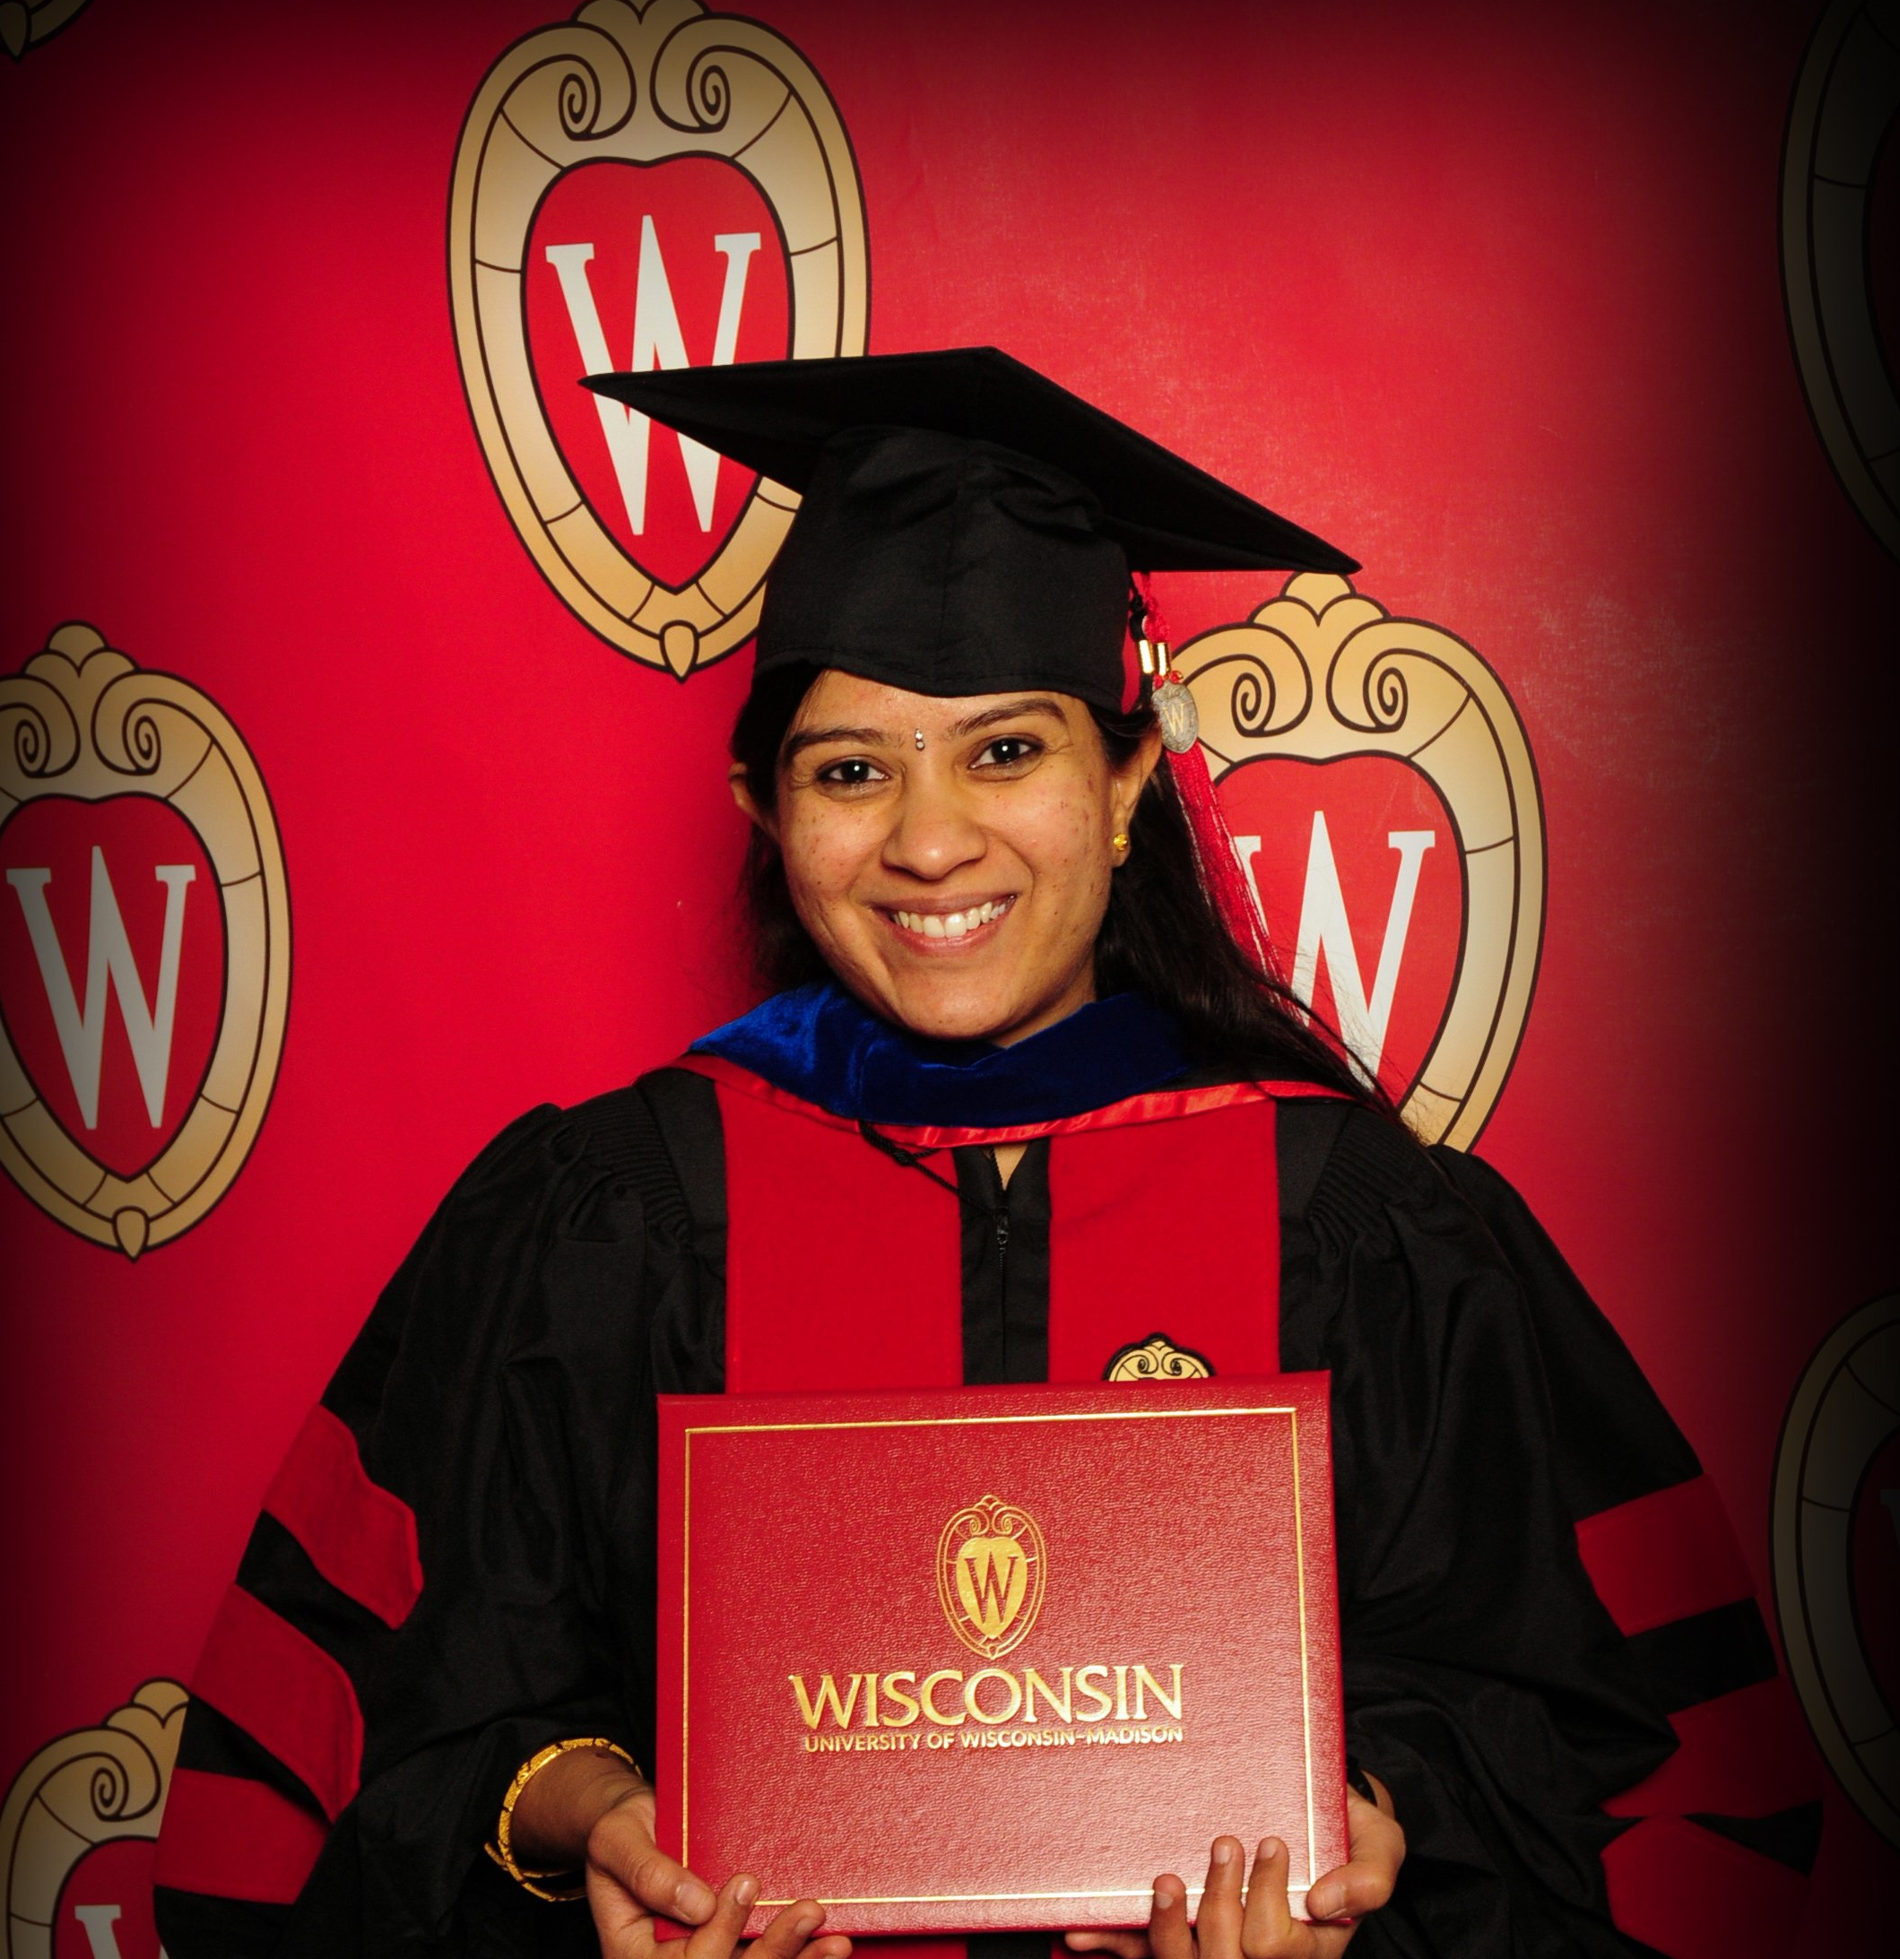
Who am I?
Meenakshi (Meena) Syamkumar
Email: ms@cs.wisc.edu
Please call me “Meena”
Industry and Teaching experience
Citrix, Cisco, and Microsoft
CS300, CS220, CS367, guest lectures in CS640, CS740
Research
Network measurements
CS education

Slide 3

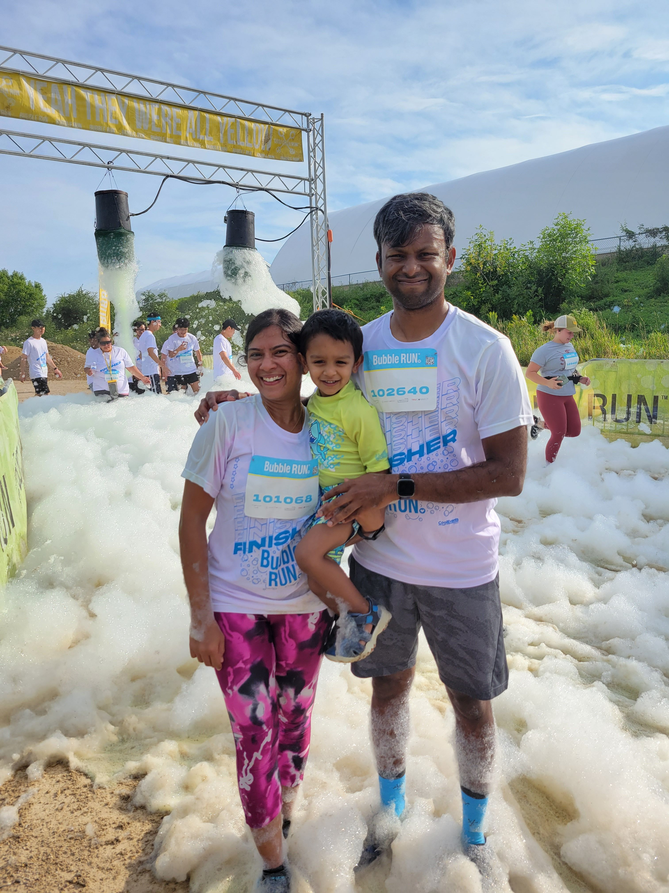
My world ☺
Passion: Running / working out

Slide 4

Who are You?
Canvas > Top Hat
Sign in with your wisc.edu school account
Please fill this form (due next Monday, Jan 30th):
https://forms.gle/KqvLHGrCvuP9Z7wF9
Why?
Help me get to know you
Get survey credit
Group formation

Slide 5


Related courses
Upper Level Computer Science
Upper Level Data Science
CS 400
CS 354
CS 300
CS 320
STAT 340
L I S 461
CS 252
CS 200
CS 220
STAT 240
systems
(C)
programming
(Java)
data programming
(Python)
data modeling
(R)
ethics
P1 (Project 1) will help 300-to-320 students pickup Python.

Slide 6
Welcome to Data Science Programming II!
Builds on CS220. https://stat.wisc.edu/undergraduate-data-science-studies/
CS220
CS320
getting results
getting reproducible results
writing correct code
writing efficient code
using objects
designing new types of objects
functions: f(obj)
methods: obj.f()
lists + dicts
graphs + trees
analyzing datasets
collecting + analyzing datasets
plots
animated visualizations
tabular analysis
simple machine learning
CS220 content (for review): https://cs220.cs.wisc.edu/f22/schedule.html

Slide 7
Course Logistics

Slide 8
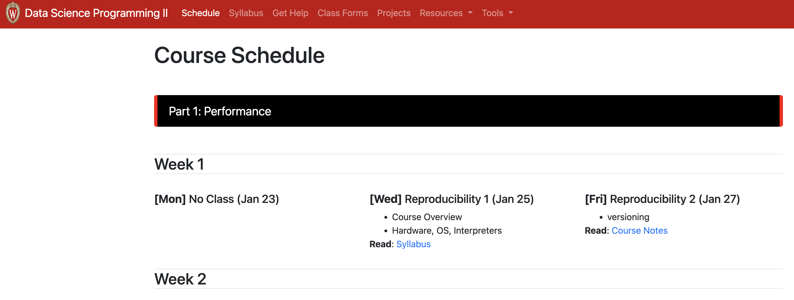
Course Website
It's here: https://www.msyamkumar.com/cs320/s23/schedule.html
read syllabus carefully
and checkout other content
I'll also use Canvas for four things:
general announcements
quizzes
online office hours
grade summaries & exam location / answers (individual messages)

Slide 9
Scheduled Activities
Lectures
3 times weekly; recommendation: bring your laptop
Required for participation credit! Attendance recorded via TopHat quizzes (20% score drops)
will often be recorded + posted online (questions will be recorded -- feel free to save until after if you aren't comfortable being recorded)
might not post if bad in-person attendance or technical issues
Lab
Weekly on Mondays or Tuesdays, bring a laptop
Work through lab exercises with group mates
320 staff will walk around to answer questions
Required for participation credit! Attendance recorded using name cards (3 score drops)
5 points per lab
1 point for arriving on time, 3 points for working on the lab, 1 point for staying until end of the lab

Slide 10
Class organization: People
Teams
you'll be assigned to a team of 4-7 students (from the same lab)
teams will last the whole semester
some types of collaboration with team members are allowed (not required) on graded work, such as projects + quizzes
collaboration with non-team members in not allowed
Staff
Instructor
Teaching Assistants (grad students) – Group TA
Mentors (undergrads)
We all provide office hours.
Office hours are drop-in (no need to reserve).

Slide 11
Communication
Piazza
find link on site
don't post >5 lines of project-related code (considered cheating)
Forms
https://www.msyamkumar.com/cs320/s23/surveys.html
Student Information Survey. Exam conflicts. Grading Issues. Feedback form. Thank you form!
Email (least preferred)
me: ms@cs.wisc.edu
Head TA: Yiyin yshen82@wisc.edu
Course staff: https://canvas.wisc.edu/courses/343506/pages/cs320-staff

Slide 12
Graded Work: Exams / Quizzes
Ten Online Quizzes - 1% each (10% overall)
cumulative, no time limit
on Canvas, open book/notes
can take together AT SAME TIME with team members (no other human help allowed)
Midterms - 13% each (26% overall)
cumulative, individual, multi-choice, 40 minutes
one-page two-sided note sheet
in class: March 3rd, April 7th
Final - 15%
cumulative, individual, multi-choice, 2 hours
one-page two-sided note sheet
May 12th 10:05AM - 12:05PM

Slide 13
Graded Work: Projects
7 Projects - 6% each (42% overall)
format: notebook, module, or program
part 1: you can optionally collaborate with team
part 2: must be individually (only help from 320 staff)
regular deadlines on course website
late days: overall 12 late days
hard deadline: 7 days after the regular deadline – maximum 3 late days; 5% score penalty per day after day 3
still a tester.py, but more depends on TA evaluation (more plots)
clearing auto-grader on the submission portal (course website) is mandatory
ask for specific feedback (constructive)

Slide 14
Graded Work: Attendance + Surveys
Lab attendance - 4% overall
3 score drops:
use these wisely – potential sickness, planned absences
no other exceptions
Lecture attendance - 2% overall
20% score drops
Surveys - 1% overall

Slide 15
Letter Grades
Your final grade is based on sum of all points earned.
Your grade does not depend on other students' grade.
Scores will NOT be rounded off at the end of the semester
No major score changes at the end of the semester
No extra credit
93% - 100%: A
88% - 92.99%: AB
80% - 87.99%: B
75% - 79.99%: BC
70% - 74.99%: C
60% - 69.99%: D
Grade cut-offs

Slide 16
Time Commitment & Academic Conduct
Project commitment
10-12 hours per project is typical
20% of students sometimes spend 20+ hours on some projects
recommendation: start early and be proactive
Typical Weekly Expectations
4 hours - lecture/lab
6 hours - project coding
2 hours - reading/quizzes/etc
Please talk to me if you're feeling overwhelmed with 320 or your semester in general.
Academic Conduct
Read syllabus to make sure you know what is and isn’t acceptable.
We will run plagiarism detector on project submissions.

Slide 17
Reading: same as 220/301 and some others...
I'll post links to other online articles and notes
Lectures don't assume any reading prior to class

Slide 18
Tips for 320 Success
Just show up!
Get 100% on participation, don't miss quizzes, submit group work
Use office hours
we're idle after a project release and swamped before a deadline
Do labs before projects
Take the lead on group collaboration
Learn debugging
Run the tester often
If you're struggling, reach out -- the sooner, the better

Slide 19
Today's Lecture:
Reproducibility

Slide 20
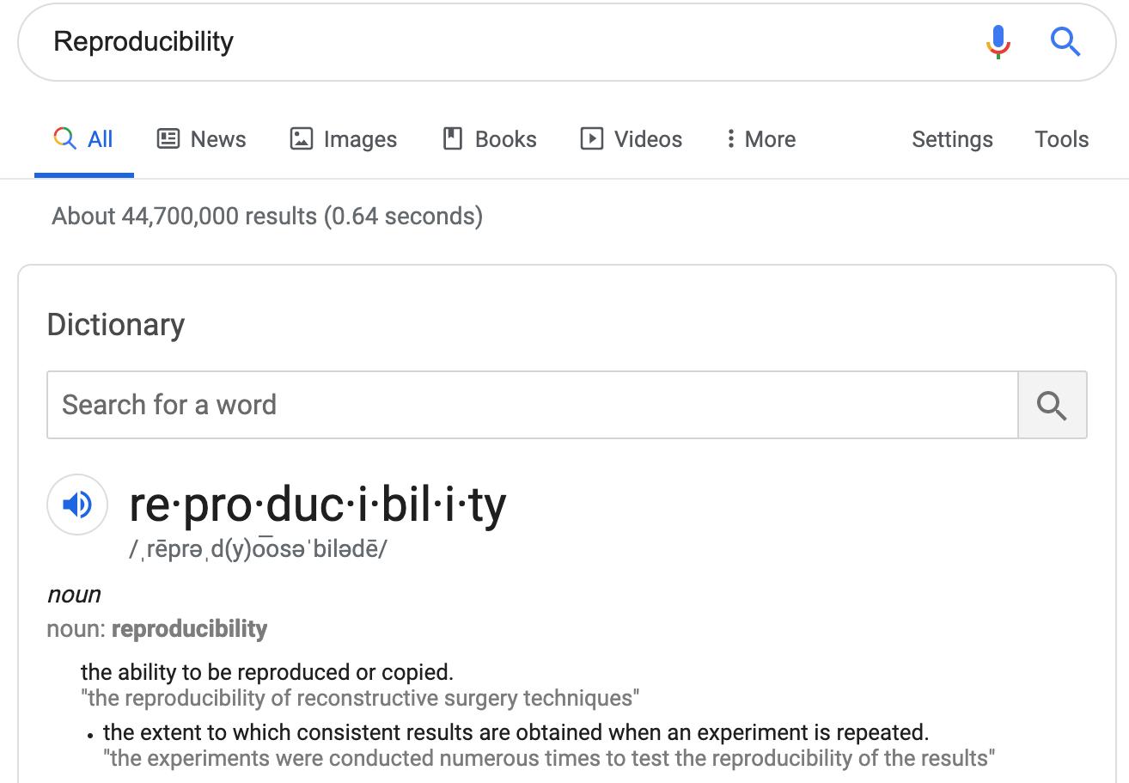
Discuss: how might we define "reproducibility" for a data scientist?

Slide 21
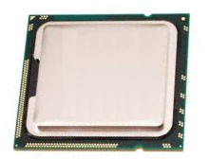
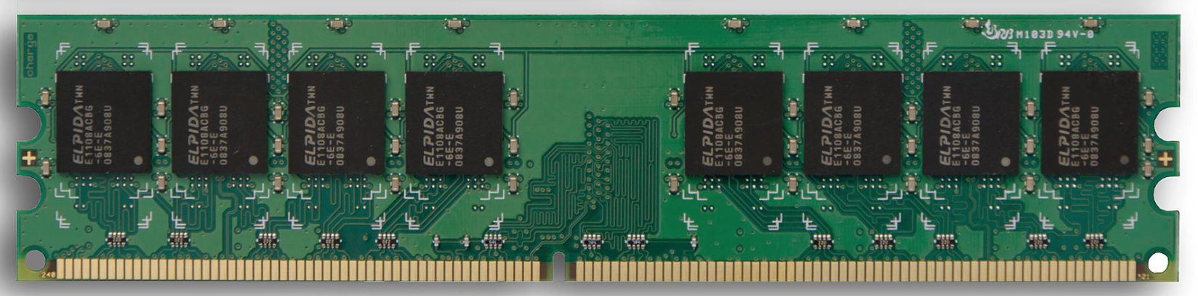
Big question: will my program run on someone else's computer? (not necessarily written in Python)
Things to match:
CPU
1
Hardware
2
Operating System
next lecture
3
Dependencies
next lecture

Slide 22
Hardware: Mental Model of Process Memory
Imagine...
one huge list, per each running program process, called "address space"
every entry in the list is an integer between 0 and 255 (aka a "byte")
values (bytes)
0
0
0
0
0
0
0
0
0
0
0
0
0
0
0
0
...
0
1
2
3
4
5
6
7
8
9
10
11
12
13
14
15
indexes (aka "addresses")

Slide 23
How can we use one giant list to handle the following?
multiple lists
variables and other references
strings
code
data
0
0
0
0
0
0
0
0
0
0
0
0
0
0
0
0
...
0
1
2
3
4
5
6
7
8
9
10
11
12
13
14
15
Is this really all we have for state?

Slide 24
How can we use one giant list to handle the following?
multiple lists
variables and other references
strings
code
0
0
0
0
0
0
0
0
3
20
0
0
11
22
33
0
...
0
1
2
3
4
5
6
7
8
9
10
11
12
13
14
15
the [3,20] list starts at index address 8 in the giant list
the [11,22,33] list starts at address 12 in the giant list

Slide 25
How can we use one giant list to handle the following?
multiple lists
variables and other references
strings
code
0
0
0
0
0
0
0
0
3
20
0
0
11
22
33
0
...
0
1
2
3
4
5
6
7
8
9
10
11
12
13
14
15
# fast
L2.append(44)
implications for performance...

Slide 26
How can we use one giant list to handle the following?
multiple lists
variables and other references
strings
code
0
0
0
0
0
0
0
0
3
20
0
0
11
22
33
44
...
0
1
2
3
4
5
6
7
8
9
10
11
12
13
14
15
# fast
L2.append(44)
implications for performance...

Slide 27
How can we use one giant list to handle the following?
multiple lists
variables and other references
strings
code
0
0
0
0
0
0
0
0
3
20
0
0
11
22
33
44
...
0
1
2
3
4
5
6
7
8
9
10
11
12
13
14
15
# fast
L2.append(44)
# slow
L2.pop(0)
implications for performance...

Slide 28
How can we use one giant list to handle the following?
multiple lists
variables and other references
strings
code
0
0
0
0
0
0
0
0
3
20
0
0
22
33
44
...
0
1
2
3
4
5
6
7
8
9
10
11
12
13
14
15
# fast
L2.append(44)
# slow
L2.pop(0)
implications for performance...

Slide 29
How can we use one giant list to handle the following?
multiple lists
variables and other references
strings
code
0
0
0
0
0
0
0
0
3
20
0
0
22
33
44
0
...
0
1
2
3
4
5
6
7
8
9
10
11
12
13
14
15
# fast
L2.append(44)
# slow
L2.pop(0)
We'll think more rigorously about
performance in CS 320 (big-O notation)

Slide 30
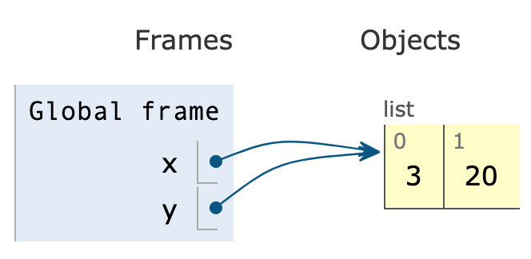
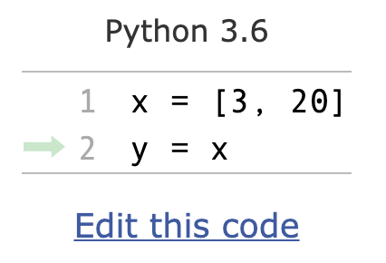
How can we use one giant list to handle the following?
multiple lists
variables and other references
strings
code
the x variable is at address 3
the y variable is at address 5
0
0
0
8
0
8
0
0
3
20
0
0
0
0
0
0
...
0
1
2
3
4
5
6
7
8
9
10
11
12
13
14
15
PythonTutor's visualization

Slide 31
How can we use one giant list to handle the following?
multiple lists
variables and other references
strings
code
discuss: how?
0
0
0
0
0
0
0
0
0
0
0
0
0
0
0
0
...
0
1
2
3
4
5
6
7
8
9
10
11
12
13
14
15
Is this really all we have for state?

Slide 32
How can we use one giant list to handle the following?
multiple lists
variables and other references
strings
code
???
0
0
0
0
0
0
0
0
0
0
0
0
0
67
65
66
...
0
1
2
3
4
5
6
7
8
9
10
11
12
13
14
15
code
65
66
67
68
...
letter
A
B
C
D
...
encoding:
f = open("file.txt", encoding="utf-8")

Slide 33
How can we use one giant list to handle the following?
multiple lists
variables and other references
strings
code
"CAB"
0
0
0
0
0
0
0
0
0
0
0
0
0
67
65
66
...
0
1
2
3
4
5
6
7
8
9
10
11
12
13
14
15
code
65
66
67
68
...
letter
A
B
C
D
...
encoding:
f = open("file.txt", encoding="utf-8")

Slide 34
How can we use one giant list to handle the following?
multiple lists
variables and other references
strings
code
i = 0
while ????:
i += 2
# what line next?
operands
operator
0
0
0
0
0
0
0
0
...
...
5
4
2
33
10
0
...
0
1
2
3
4
5
6
7
8
9
10
11
12
13
14
15
code
5
8
33
...
operation
ADD
SUB
JUMP
...
Instruction Set
Notes:
f22: section 1

Slide 35
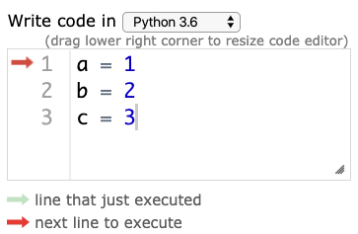

Hardware: Mental Model of CPU
CPUs interact with memory:
keep track of what instruction we're on
understand instruction codes
much more
CPU
0
0
0
0
0
0
0
0
...
...
5
4
2
33
10
0
...
0
1
2
3
4
5
6
7
8
9
10
11
12
13
14
15
code
5
8
33
...
operation
ADD
SUB
JUMP
...
Instruction Set

Slide 36
Hardware: Mental Model of CPU
CPUs interact with memory:
keep track of what instruction we're on
understand instruction codes
much more
CPU
add 2 to variable
0
0
0
0
2
0
0
0
...
...
5
4
2
33
10
0
...
0
1
2
3
4
5
6
7
8
9
10
11
12
13
14
15
code
5
8
33
...
operation
ADD
SUB
JUMP
...
Instruction Set

Slide 37
Hardware: Mental Model of CPU
CPUs interact with memory:
keep track of what instruction we're on
understand instruction codes
much more
CPU
go back to top of loop
0
0
0
0
2
0
0
0
...
...
5
4
2
33
10
0
...
0
1
2
3
4
5
6
7
8
9
10
11
12
13
14
15
code
5
8
33
...
operation
ADD
SUB
JUMP
...
Instruction Set

Slide 38
Hardware: Mental Model of CPU
CPUs interact with memory:
keep track of what instruction we're on
understand instruction codes
much more
CPU
0
0
0
0
2
0
0
0
...
...
5
4
2
33
10
0
...
0
1
2
3
4
5
6
7
8
9
10
11
12
13
14
15
code
5
8
33
...
operation
ADD
SUB
JUMP
...
Instruction Set

Slide 39
Hardware: Mental Model of CPU
discuss: what would happen if a CPU tried to execute an instruction for a different CPU?
0
0
0
0
0
0
0
0
...
...
5
4
2
33
10
0
...
0
1
2
3
4
5
6
7
8
9
10
11
12
13
14
15
code
5
8
33
...
operation
ADD
SUB
JUMP
...
code
5
8
33
...
operation
SUB
ADD
undefined
...
Instruction Set
for CPU X
Instruction Set
for CPU Y
Notes:
s22: lec 1+2 ended here

Slide 40
Hardware: Mental Model of CPU
a CPU can only run programs that use instructions it understands!
CPU Y
0
0
0
0
0
0
0
0
...
...
5
4
2
33
10
0
...
0
1
2
3
4
5
6
7
8
9
10
11
12
13
14
15
code
5
8
33
...
operation
ADD
SUB
JUMP
...
code
5
8
33
...
operation
SUB
ADD
undefined
...
Instruction Set
for CPU X
Instruction Set
for CPU Y

Slide 41
A Program and CPU need to "fit"
Program A
Program B
CPU X
CPU Y
Program B
Program A
CPU X
CPU Y

Slide 42
A Program and CPU need to "fit"
Program A
Program B
CPU X
CPU Y
why haven't we noticed this yet for our Python programs?

Slide 43
Interpreters
program.py
same
program.py
python code
python.exe (X)
python.exe (Y)
different
machine code
CPU X
CPU Y
different
Interpreters (such as python.exe) make it easier to run the same code on different machines
A compiler is another tool for running the same code on different CPUs

Slide 44
Interpreters
program.py
same
program.py
python code
python.exe (X)
different
python.exe (Y)
machine code
CPU X
different
CPU Y
Interpreters (such as python.exe) make it easier to run the same code on different machines
Discuss: if all CPUs had the instruction set,
would we still need a Python interpreter?

